Slide 1
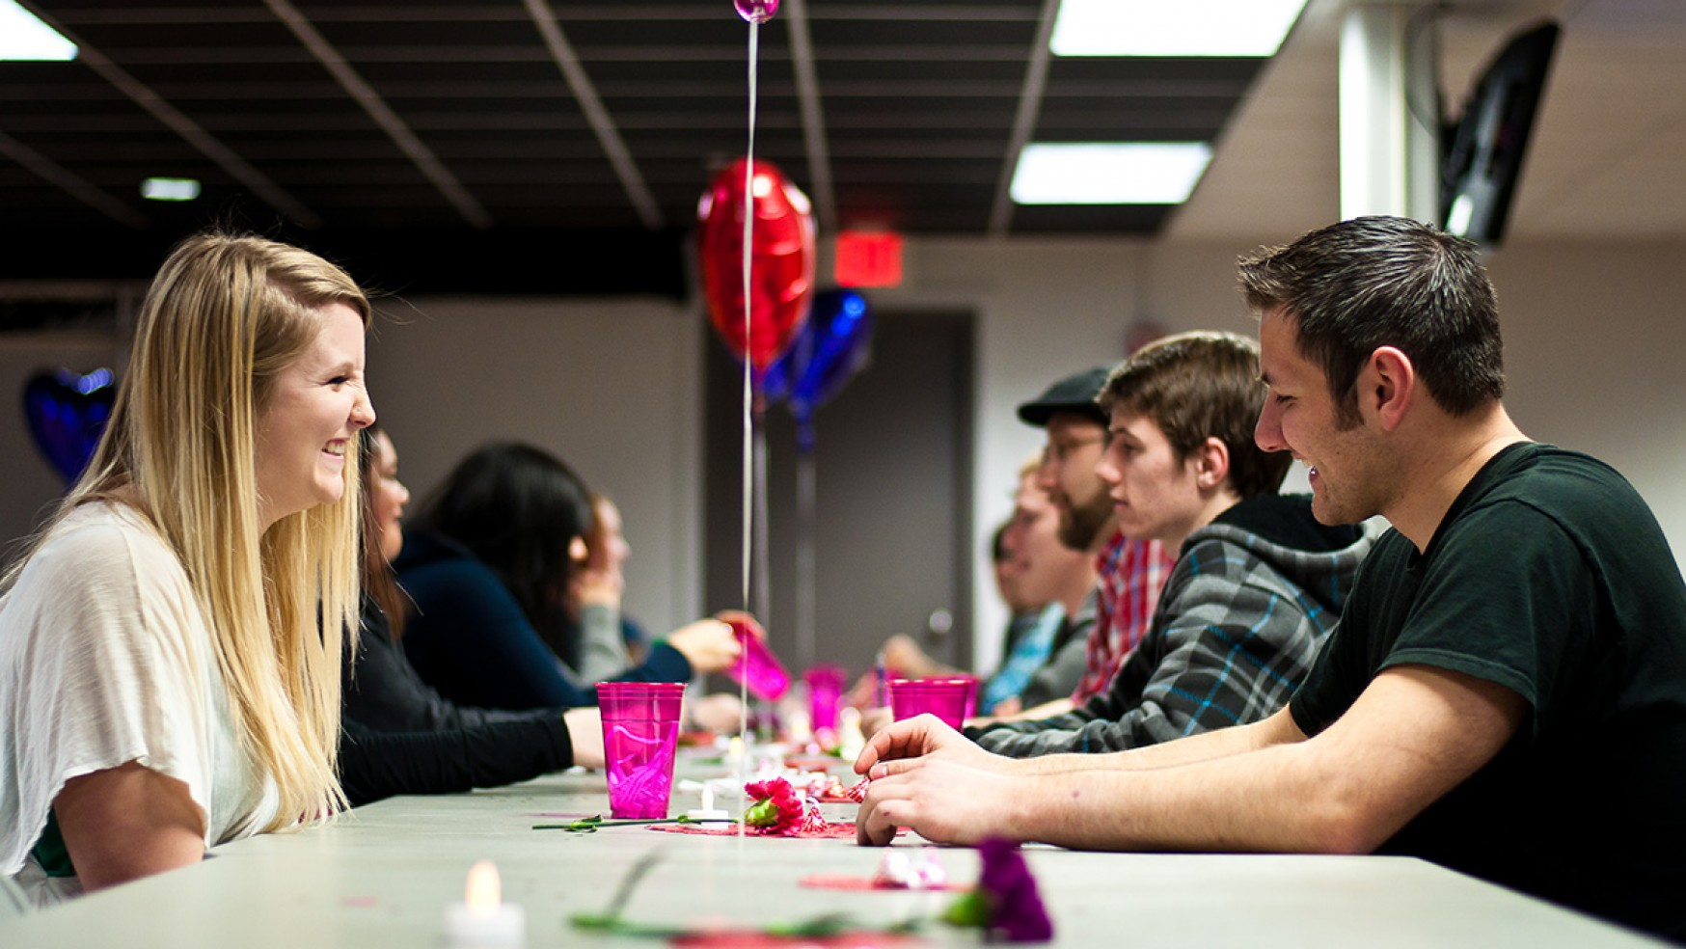
What predicts speed dating success
NYC-DAT-37
Chen S

Slide 2
The Question
Can we predict the target: speed dating participant’s decision to go on a date, with the following features:
Age
Gender
Same race
Field of study
Shared interest
Attributes: attractive, sincere, intelligent, fun, ambitious, share interest
Diff. (age, and attributes)

Slide 3
Data - Source
This dataset was compiled by Columbia Business School professors Ray Fisman and Sheena Iyengar for their papers:
“Gender Differences in Mate Selection: Evidence From a Speed Dating Experiment” (Fisman, Iyengar, et al., The Quarterly Journal of Economics, 2006)
“Racial Preference in Dating” (Iyengar et al., Review of Economic Studies 2008)

Slide 4
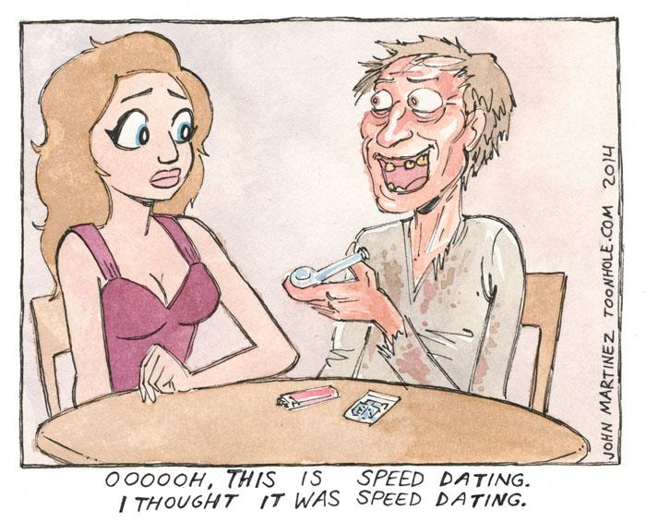
Data - Collection
Speed dating events from 2002-2004.
Grad and professional schools at Columbia University
Bar/restaurants, no alcohol
Four minute "first date" with every other participant of the opposite sex.
At the end of their four minutes, participants were asked if they would like to see their date again.
Notes:
Subjects met a number of potential mates in the bar. Each group had 10-20 participants. Each pair had 4 minutes to have a conversation. They were asked to fill in a survey on basic information of the themselves. At the end of the 4 minutes, they were asked to indicate if they would like to go on another date with the other person. If there’s a match, the next day after speed dating, participants were given the other person’’s contact info.
Our subjects were drawn from students in graduate and professional schools at Columbia University. Participants were recruited through a combination of mass e-mail and fliers posted throughout the campus and handed out by research assistants.
Setting is bar/restaurant close to campus. No alcohol was served.

Slide 5
Data - Clean-up
There were 195 features in the original data frame. Features are, for example: gender, id, partner#, match, same race, decision, age, field of study, SAT score, tuition, race, zipcode (growing up), income, goal of coming to this event, career goal, attractive, fun, sincere, generous, ambitious
In total, there were 8378 records.
I selected 27 features: decision, gender, interest correlation, same race, age, race, attributes, field of study.
I added 7 features: diff.
Notes:
Features are from the survey that participants filled in. Basic information (their age, gender, race, income, zip code, where they were from, field of study) were collected. Also, participants were asked to rate their dates on 6 attributes: attractiveness, intelligence, fun, ambitiousness, sincerity, shared interest.

Slide 6
Data - Clean-up
Categorical data:
No missing values in gender, decision, same race
Replace missing values in race and field of study with mode
Numerical data:
Replace missing values with mean
Add features:
Difference in age
Difference in attributes

Slide 7
Data - Exploratory Data Analysis
Final dataset: 34 features, 8378 entries
Gender
Male | 4194
Female | 4184
Decision
Yes | 3518 (41.99%)
No | 4860 (58.01%)

Slide 8
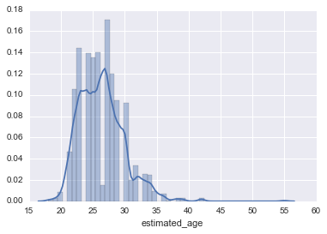
Data - Exploratory Data Analysis
African American | 420 (5.01%)
Caucasian American | 4790 (57.17%)
Hispanic American | 664 (7.93%)
Asian American | 1982 (23.66%)
Others | 522 (6.23%)

Slide 9
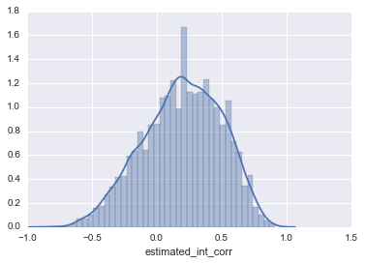
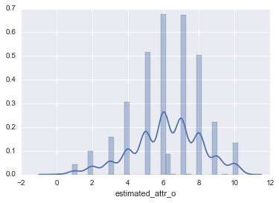
Data - Exploratory Data Analysis

Slide 10
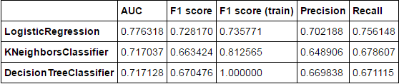
Model Selection
Train/test split: test size 0.3

Slide 11
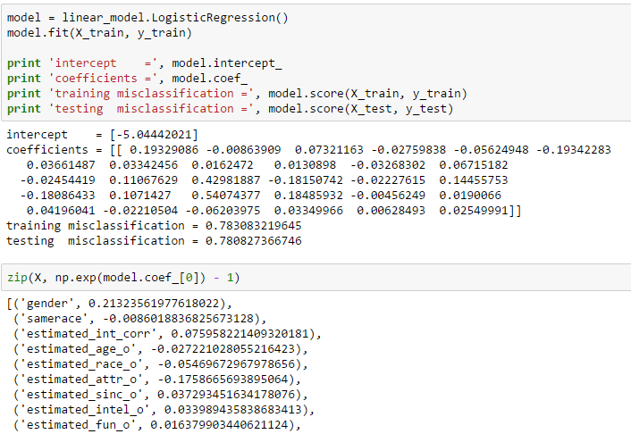
Model - Logistic Regression

Slide 12
Result - Interpretations
Gender: the odd of deciding to go on a date for a male (gender = 1) is 21% higher than that for a female. Maybe this is because women tend to be more selective.
Interest correlation: shared interest correlation increases the odd of deciding to go on a date. Seems self-explanatory.
Attractiveness: with increase in attractiveness, we saw the odd of deciding to go on a date increase (by 53%).
Sincerity: with increase in sincerity, we saw the odd of deciding to go on a date 16% lower.

Slide 13
Result - Interpretations
Fun: with increase in fun, we saw the odd of deciding to go on a date 15% higher.
Ambitiousness: with increase in ambitiousness, we saw the odd of deciding to go on a date 16% lower.
Like: with increase in like, we saw the odd of deciding to go on a date 71% higher.

Slide 14
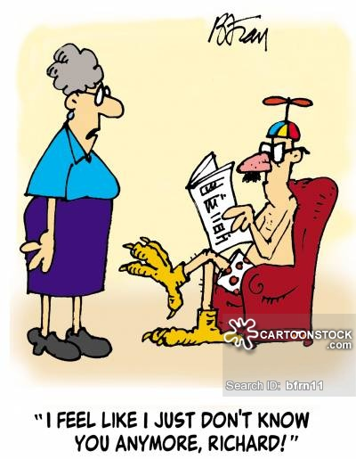
Result - Interpretations
The following features did not have large impact:
Age
Same race
Intelligent
Diffs

Slide 15
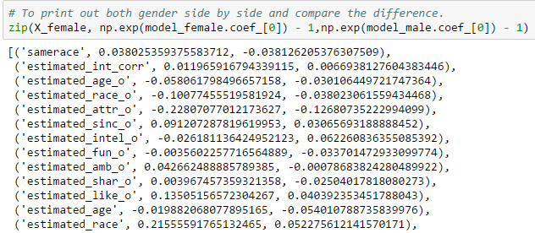
Subset - by gender

Slide 16
Subset - by gender
Same race: being with the same race increases odds of deciding to go on a date for women, while decreases that for men. This means women prefer to be dating same race while men is the opposite.
Attractiveness: with one unit of increase in attractiveness, we saw the odd of deciding to go on a date 76% higher versus 37% for women. This means men places much higher emphasis on attractiveness.
Intelligence: if women perceives men of higher intelligence, it increases odds of deciding to go on a date, while the opposite is true for men.

Slide 17
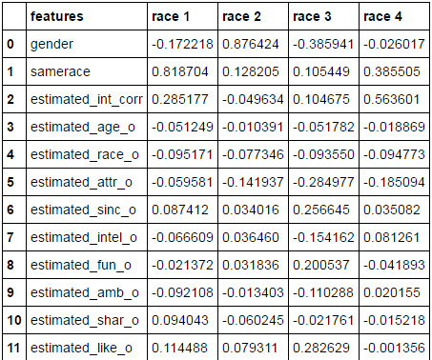
Subset - by race
Notes:
Race 1: african american
Race 2: caucasian
Race 3: hispanic
Race 4: asian

Slide 18
Subset - by race
Same race: for African American, being in the same race increases odds of going out for date by 81%, followed by Asian American 38%.
Interest correlation: with increase in interest correlation, we saw odds of going out for date increase for Asian American, African American, and Hispanic American. But it decreases odds for Caucasian American. Seems Caucasian place less emphasis on shared interest.
Age: with increase in age, we saw odds of going out for date decrease for African American and Caucasian, but slightly increases the odds for Hispanic and Asian Americans.

Slide 19
Subset - by race
Sincerity: increases odds of going out for date for African American but the opposite for all other races.
Fun: decreases odds of going out for date for African American but the opposite for all other races.
Diff in age: increases odds of going out for date for African American but the opposite for Hispanic American. Suggesting African American prefer age difference whereas Hispanic American prefer similar age.

Slide 20
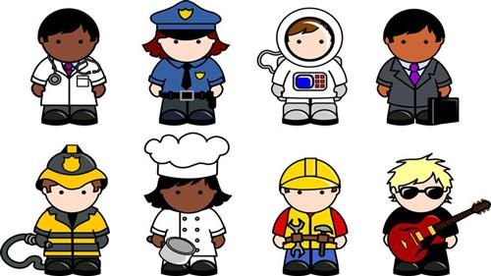
Subset - by field of study
Law | 8.01%
Med | 10.10%
Sciences | 32.50%
Arts | 25.23%
Business | 24.16%

Slide 21
Subset - by field of study
Same race: decreases the odds for Business students while increases odds of going out to a date for all other fields. Business students prefer different race.
Interest correlation: decreases Med students’ odds of going out to a date while increases the odds for all other fields. Suggesting Med students prefer to date someone who’s different from them.

Slide 22
Limitation and next steps
Data was collected from Columbia University students: a specific subset of population: educated, middle-class American.
The speed datings were set up for heterosexual couples only.
Would be interesting to include more features: income, where students were from, current zip code, SAT score.
Improve model precision, recall, F1 score.

